Slide 1
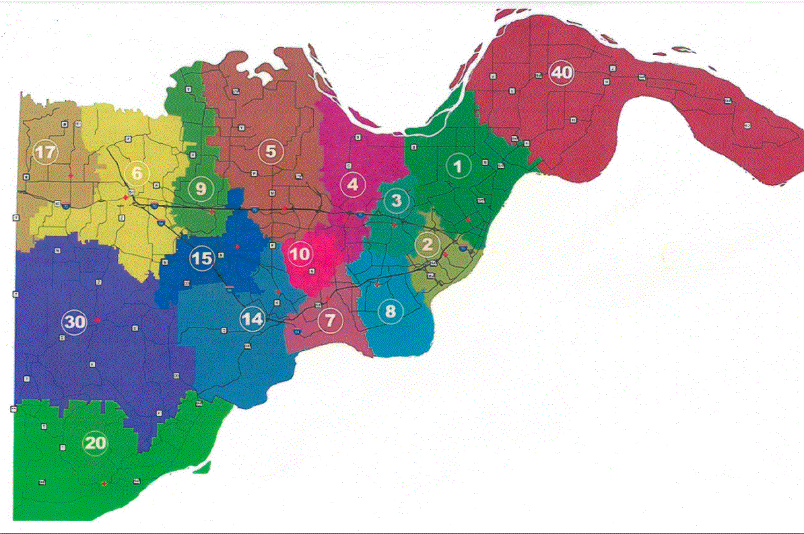
X
X
X
X
X
X
X
X
X
X
X
X
X
X
X
X

